Slide 1

My BTech Project Progress
OPUS INTERNATIONAL CONSULTANTS
SID JOTSINGANI

Slide 2
About OPUS
Multi-disciplinary infrastructure consultancy
3000+ employees in 5 countries
Buildings, transport, water etc.

Slide 3
The Problem
Intranet user interface needs to be improved
Usability is low, high complexity
Additional functionality and design improvements are required

Slide 4
The Project
Add functionality to current intranet
Improve overall usability and user experience
Many parts
Web technologies - HTML5, CSS, JavaScript + JQuery, PHP

Slide 5
The Four Parts
Profile & Management
Map
Publications Search
Funding Application Form & Management

Slide 6
The Design
Make the system more aesthetically pleasing
Small yet effective changes
Keep the structure similar

Slide 7
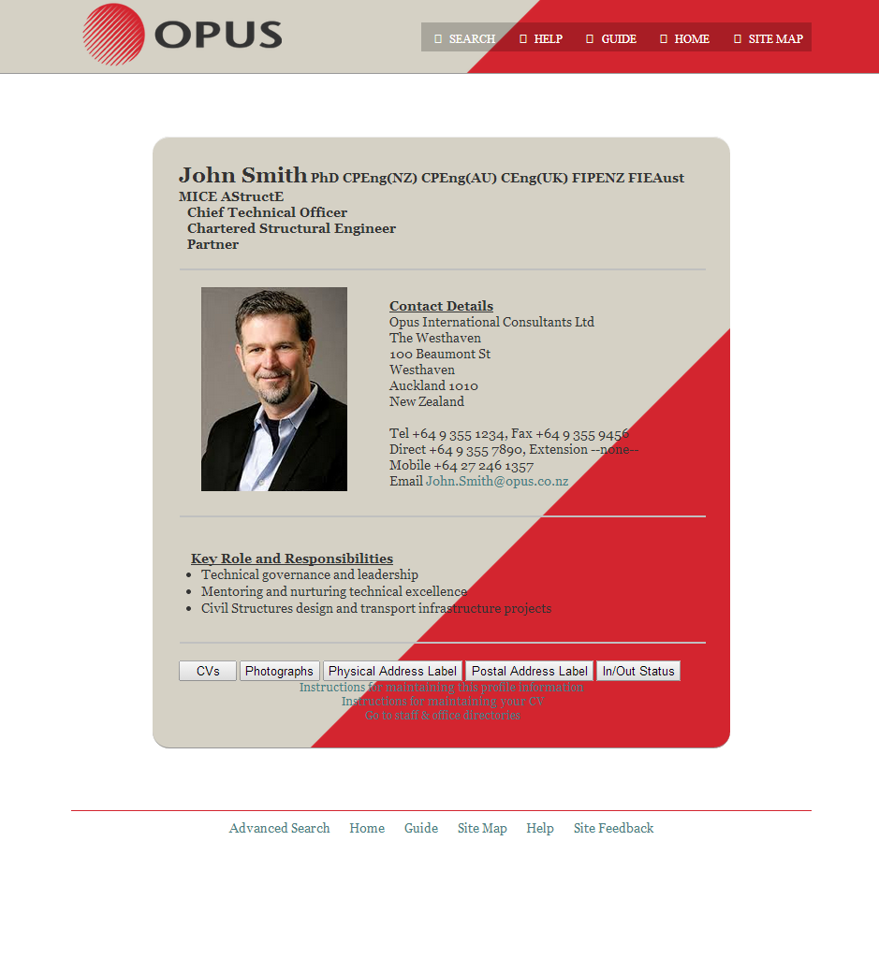
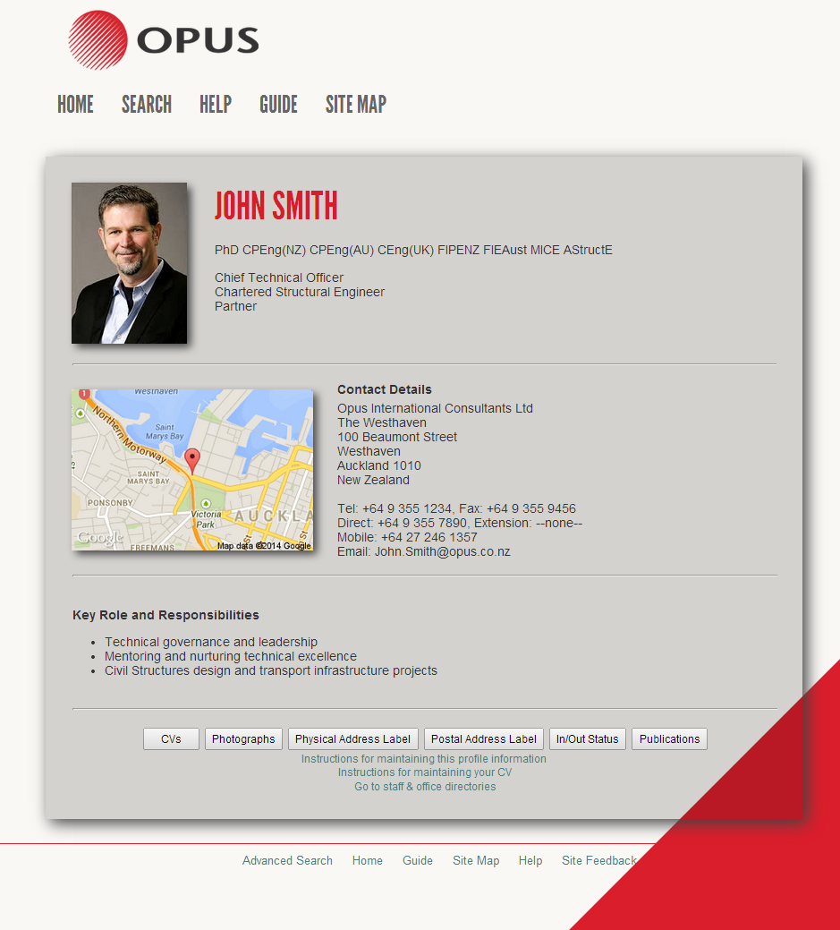
Before
After

Slide 8


Design is not just what it looks like and feels like. Design is how it works.
Steve Jobs
(1955-2011)

Slide 9
Demo

Slide 10
Limitations
Restrictions with academic databases
IT Team is based in Wellington
No access to the intranet back-end systems

Slide 11
Future
Migration to existing systems
Additional functionality
???????????????????????

Slide 12
Thank you
It’s question time!

